Slide 1
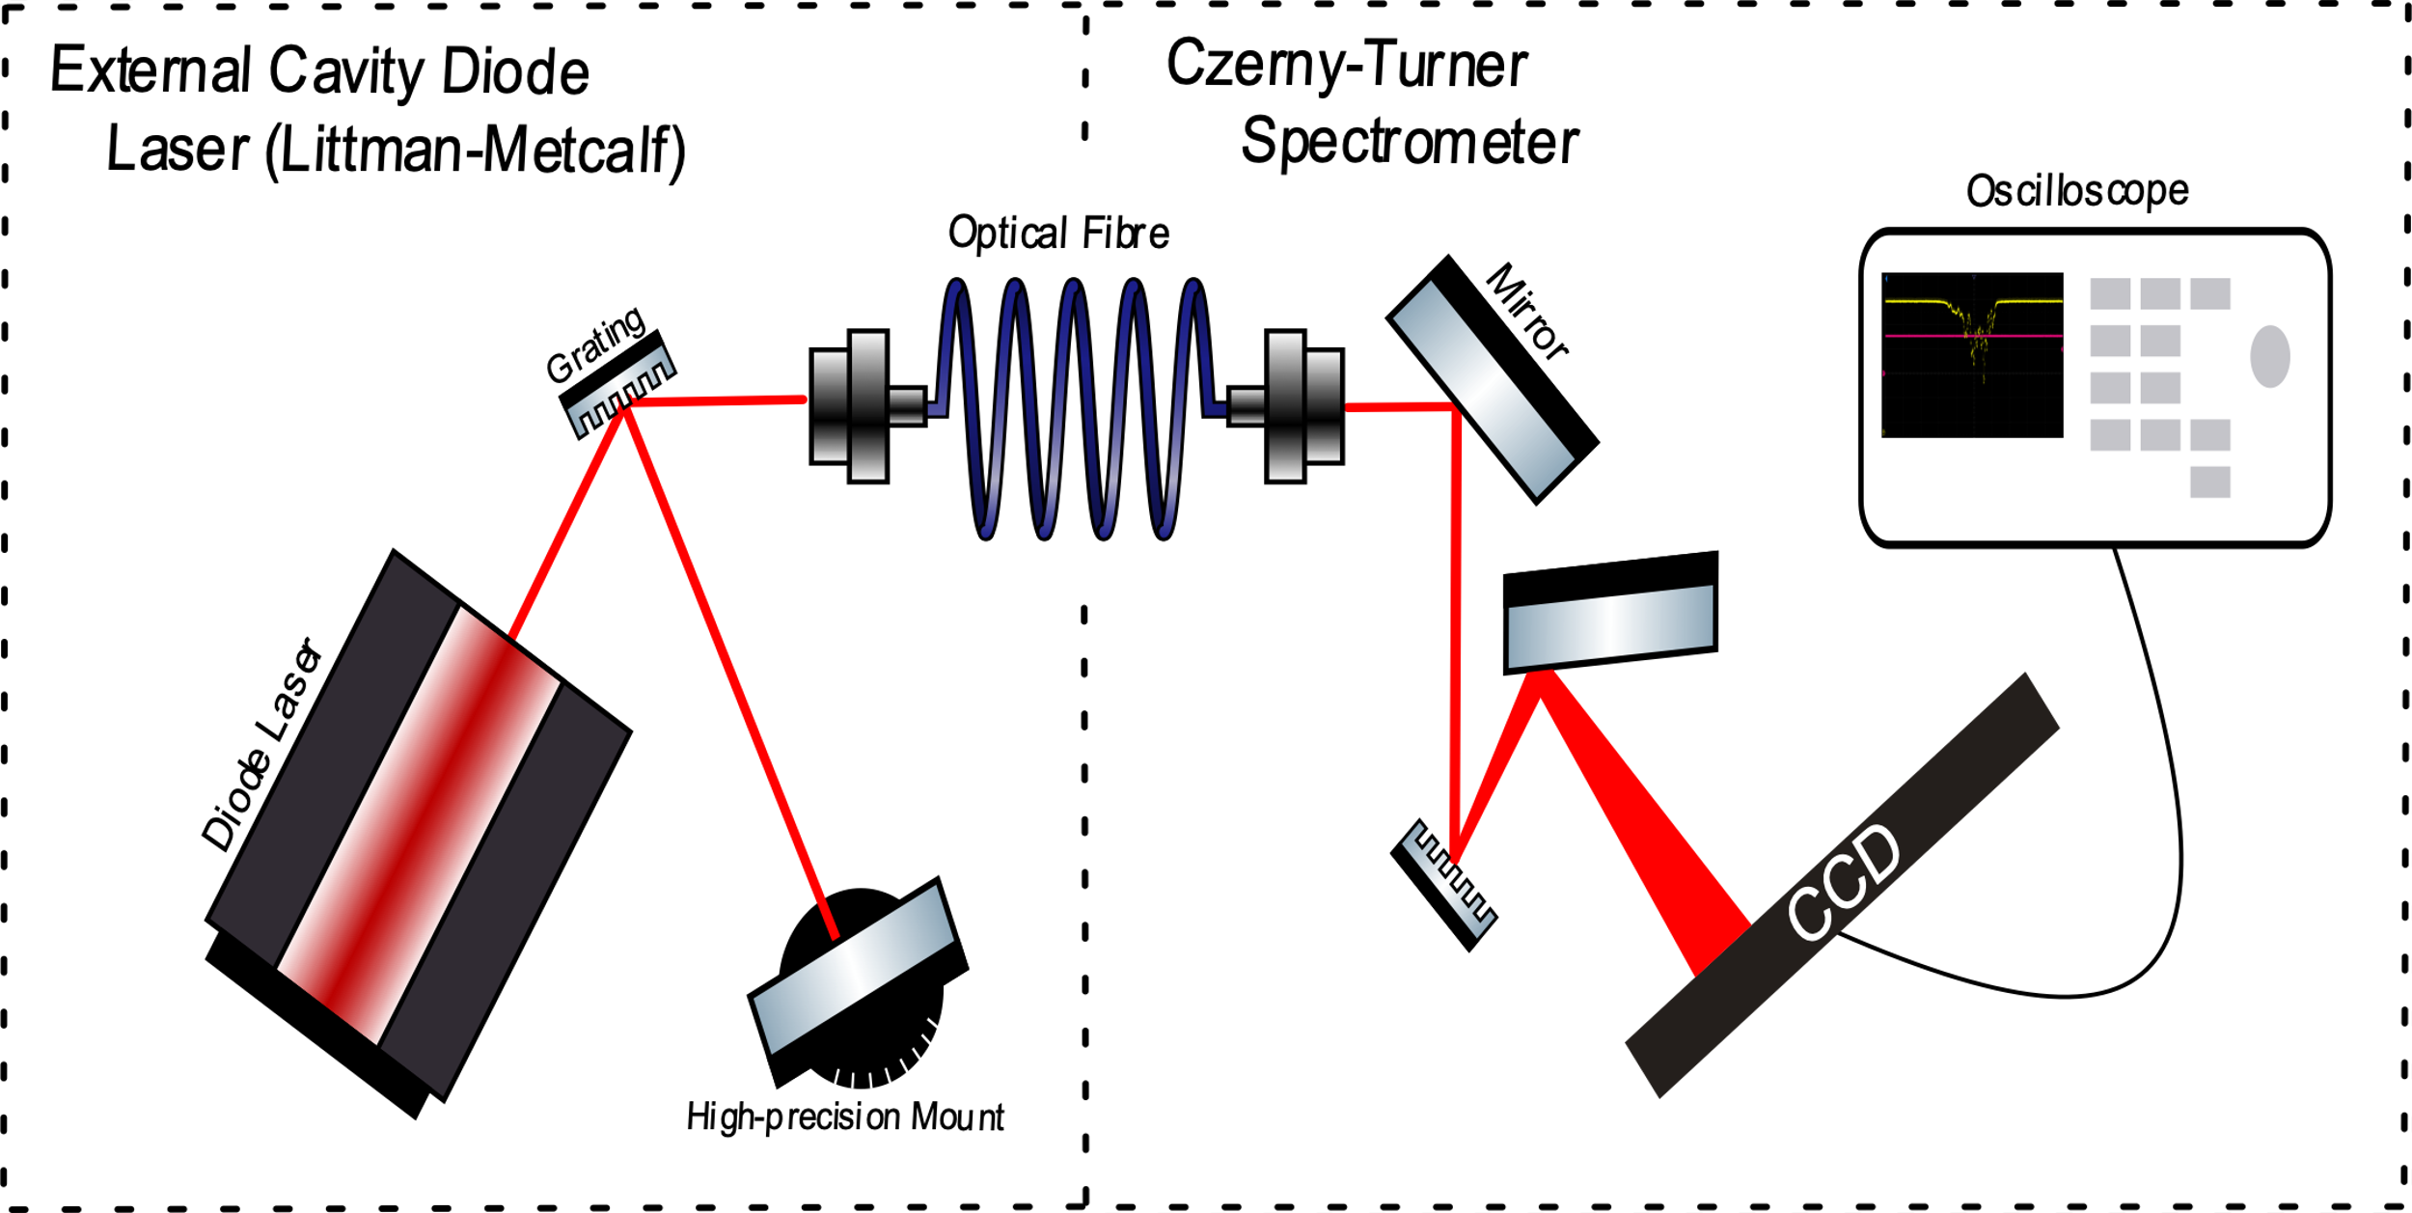
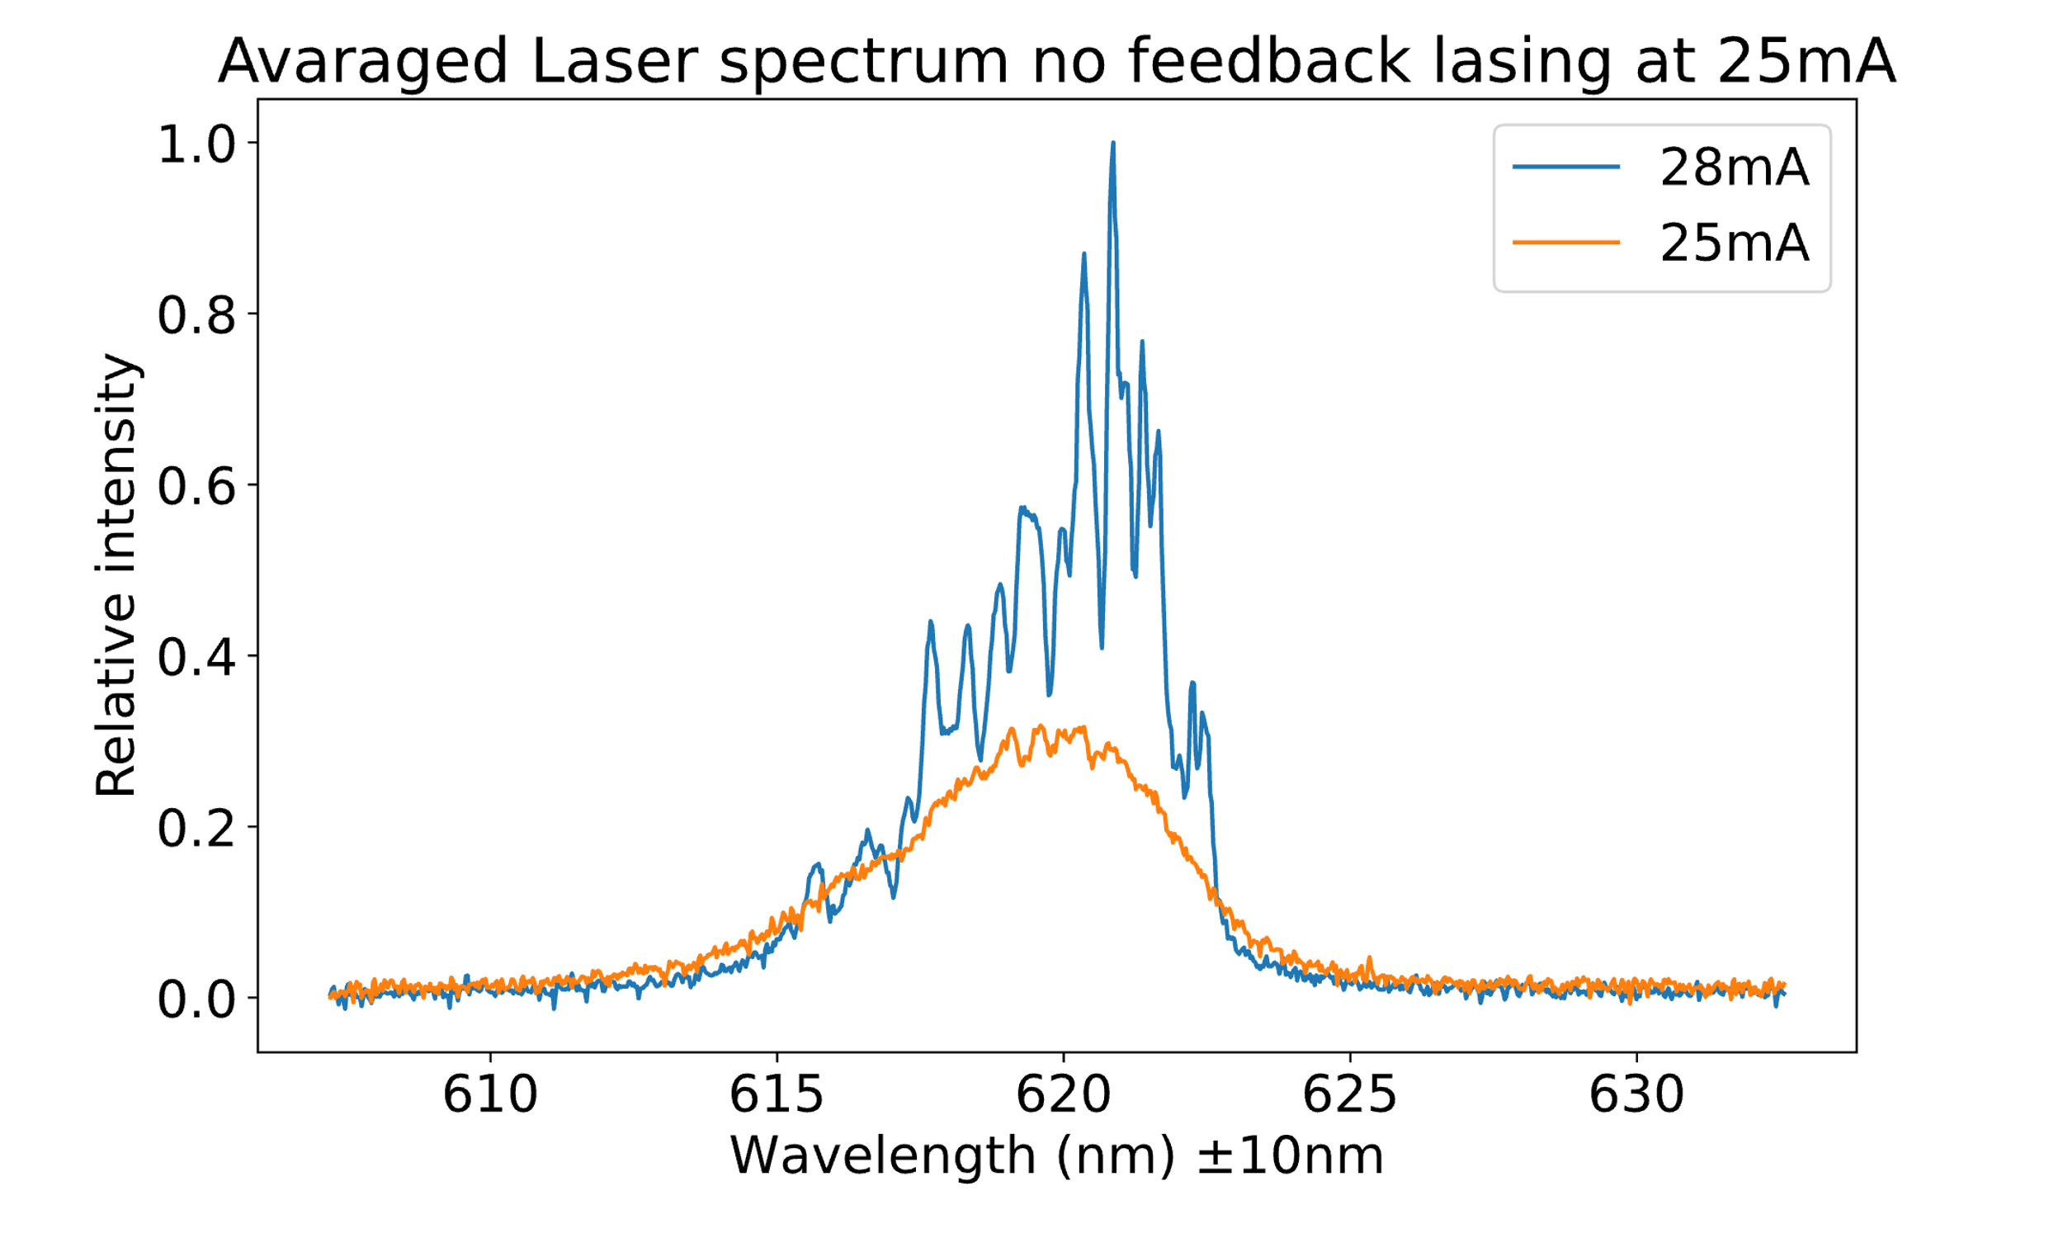
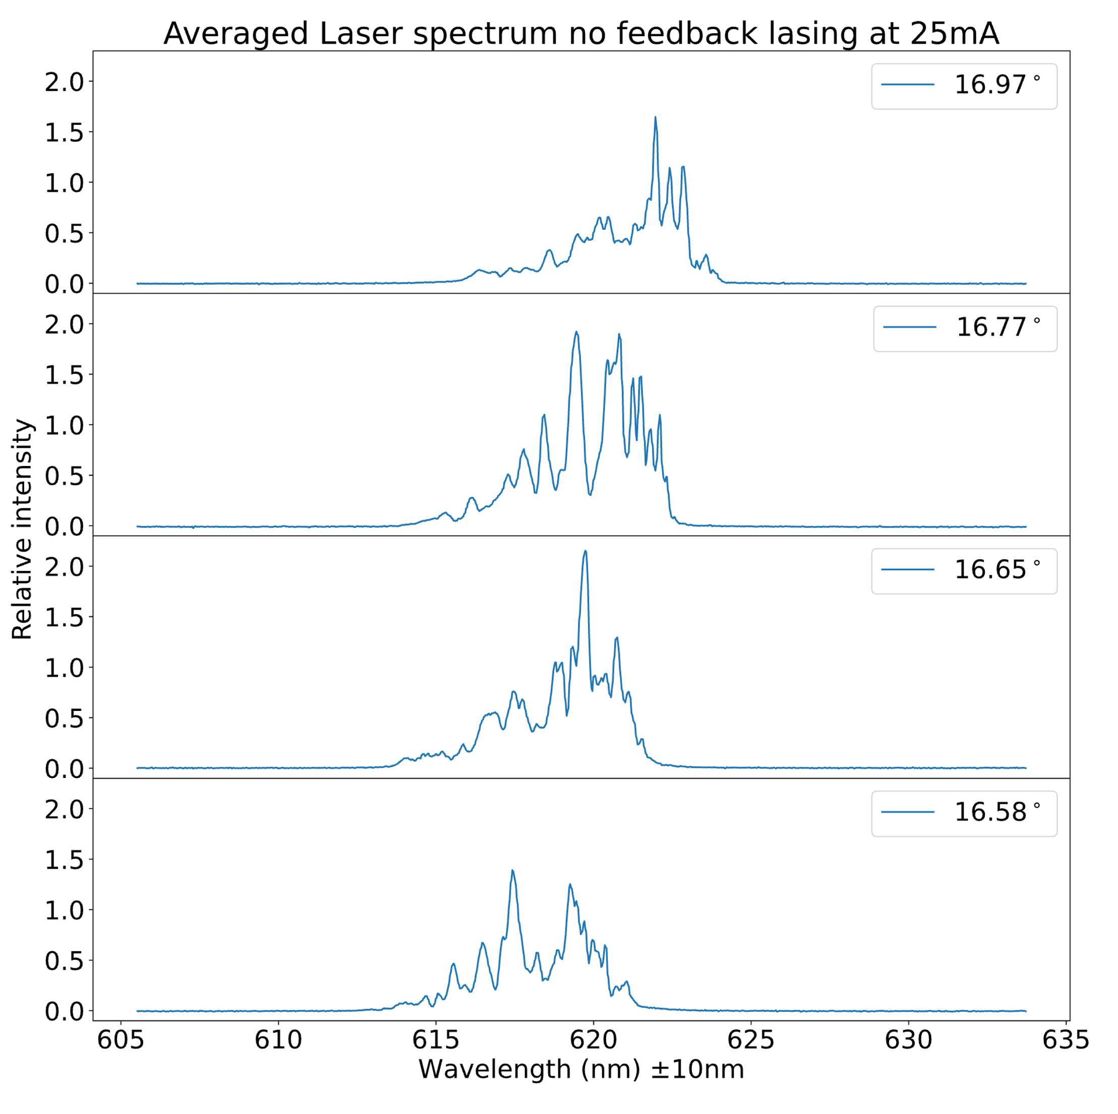
Optical Feedback
Introduction
Expectation
Introduction
Optical feedback is the process in which a select band from the output of a laser is reflected back into the laser cavity. For this project we built our own external cavity diode laser (ECDL) and Czerny-Turner Spectrometer to measure the effect that feedback has on the output of the diode laser.
Diode lasers emit photons through the harmonic oscillation of electrons between energy levels. When provided with optical feedback, the incoming beam acts as a driving force for the oscillations of electrons between energy gaps equal to the energy of the beam’s constituent wavelengths. This stimulates the emission of photons with the same wavelengths as those in the reflected beam, which is what we expect to measure with our spectrometer.
Methodology
Setup
The ECDL makes use of a Littman-Metcalf configuration, where a mirror mounted on a high-precision rotation stage selects which wavelength(s) are being feedbacked into the diode laser. The zeroth order diffraction of the ECDL is directed into a spectrometer, which displays the wavelengths present in the beam. The spectrometer is calibrated with a neon lamp.
Conclusion
I need to be written☹
Discussion
I need to be written☹
References
I need to be written☹

